Slide 1
Teradata CoE
Teradata Lab Course
CONTENTS:
1)
2)
3)
4)
5)
6)
Distinct Vs Group By Functions
Explain
Format Functions
Help and Show
Join Functions
Join Indexes

Slide 2
Teradata CoE
Teradata Lab Course
Distinct Vs. Group By

Slide 3
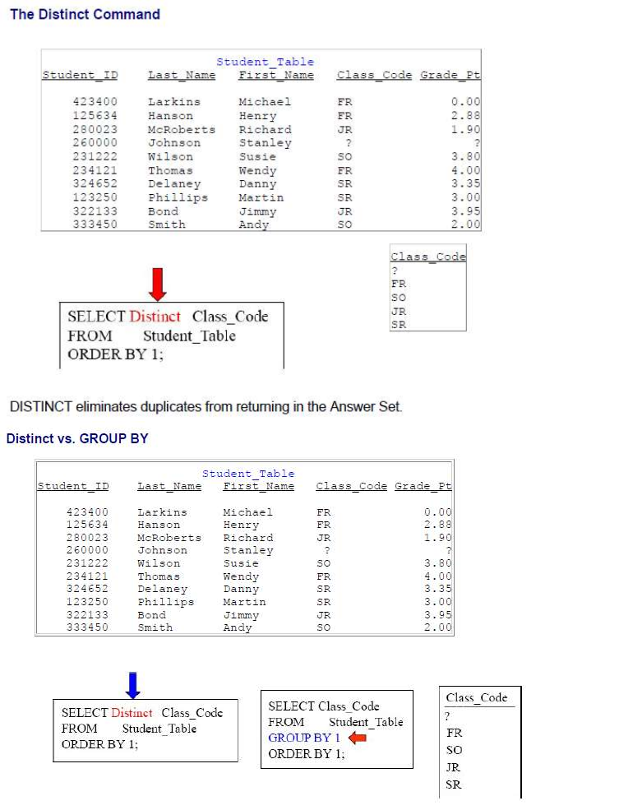
Teradata CoE
Teradata Lab Course
Distinct Vs. Group By

Slide 4
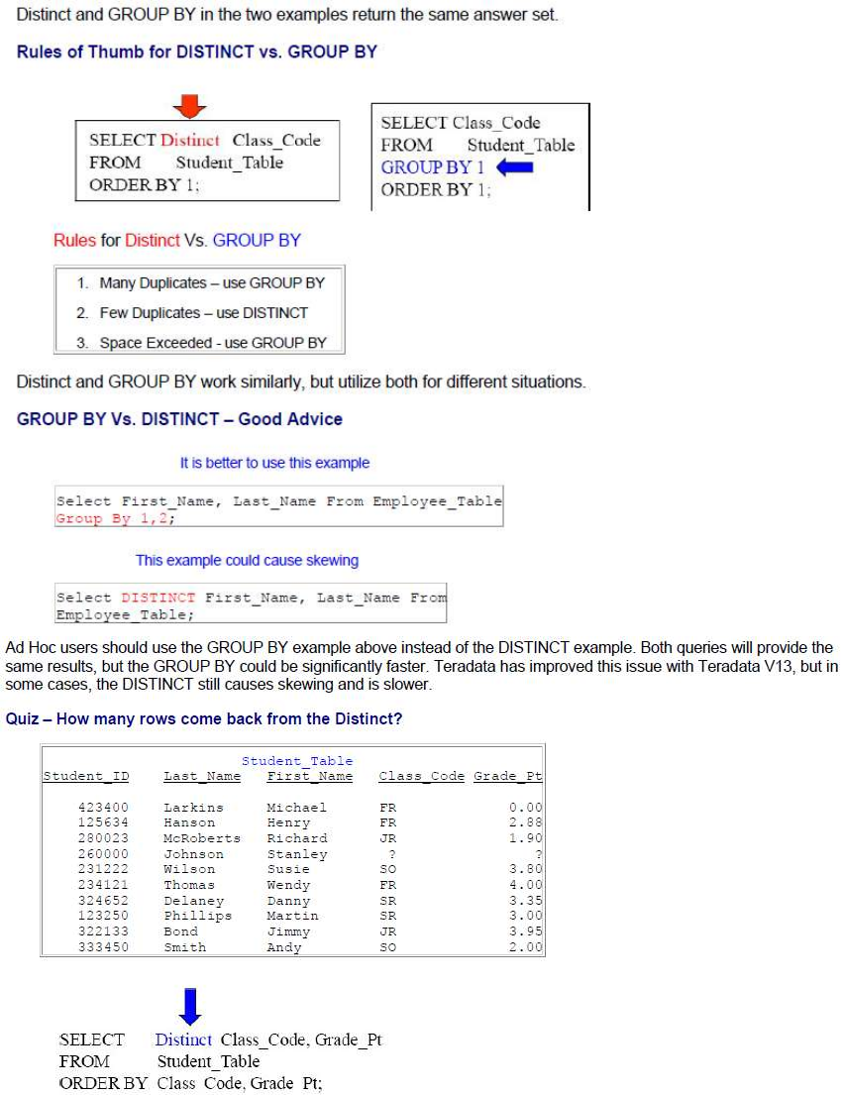
Teradata CoE
Teradata Lab Course

Slide 5
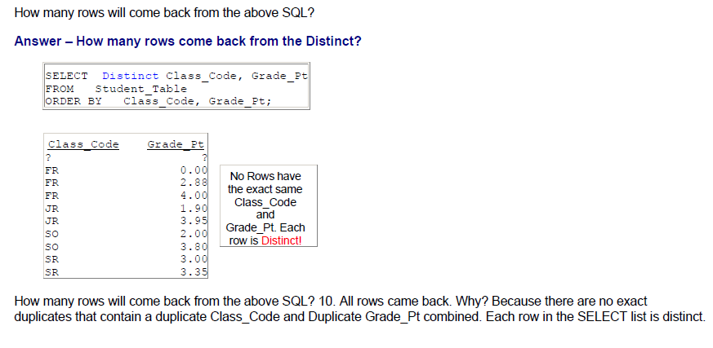
Teradata CoE
Teradata Lab Course

Slide 6
Teradata CoE
Teradata Lab Course
Explain

Slide 7
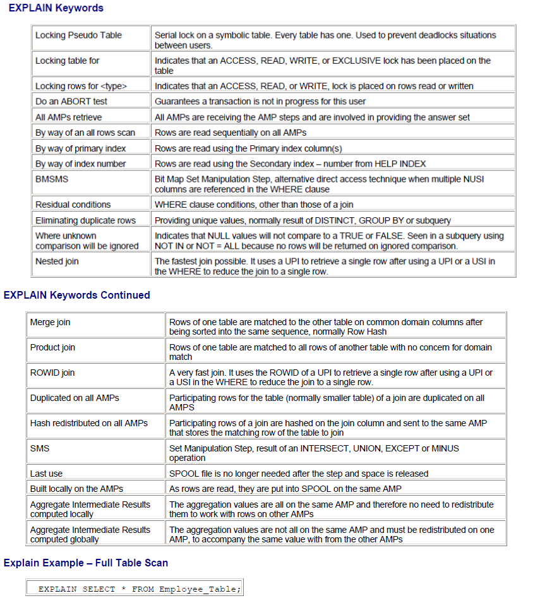
Teradata CoE
Teradata Lab Course
Explain

Slide 8
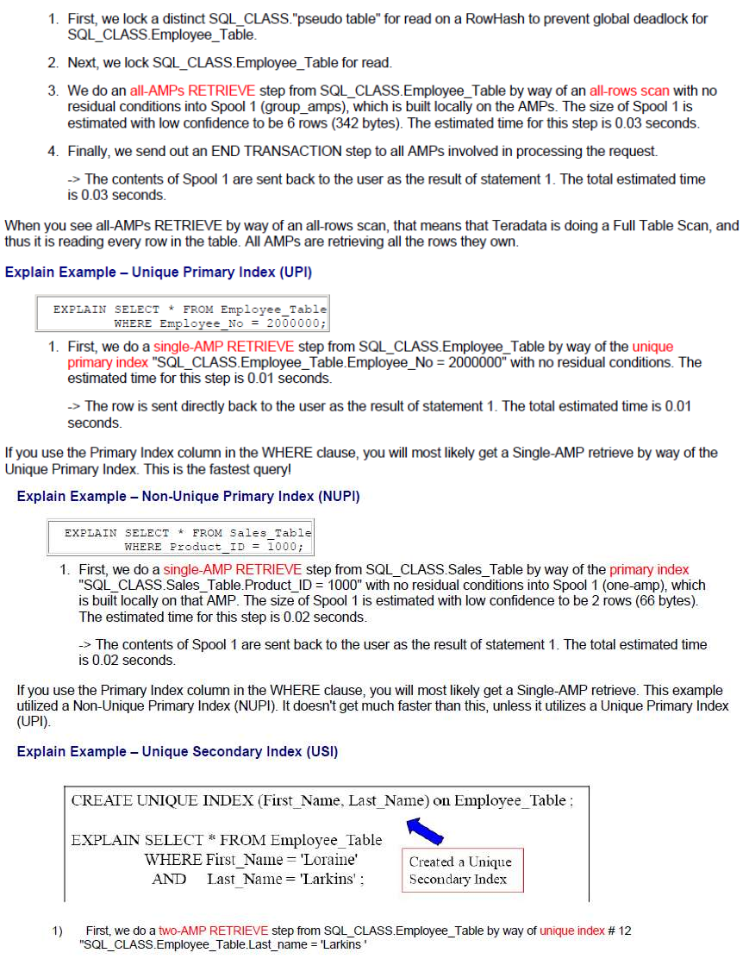
Teradata CoE
Teradata Lab Course

Slide 9
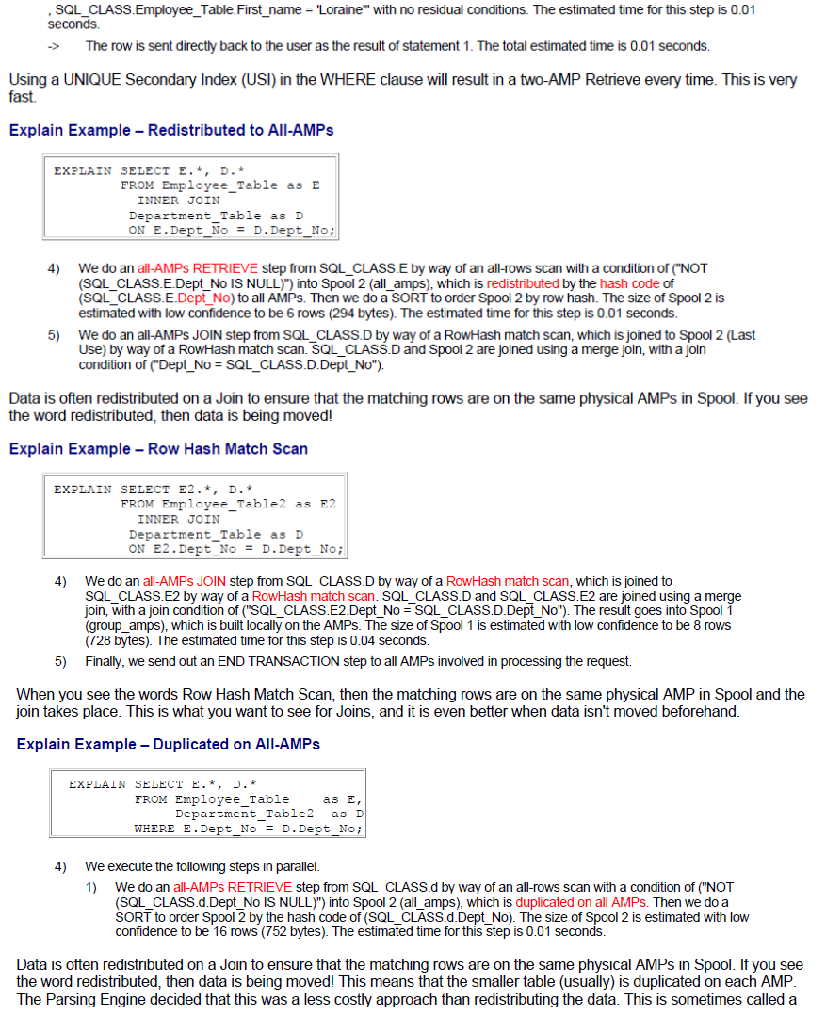
Teradata CoE
Teradata Lab Course

Slide 10
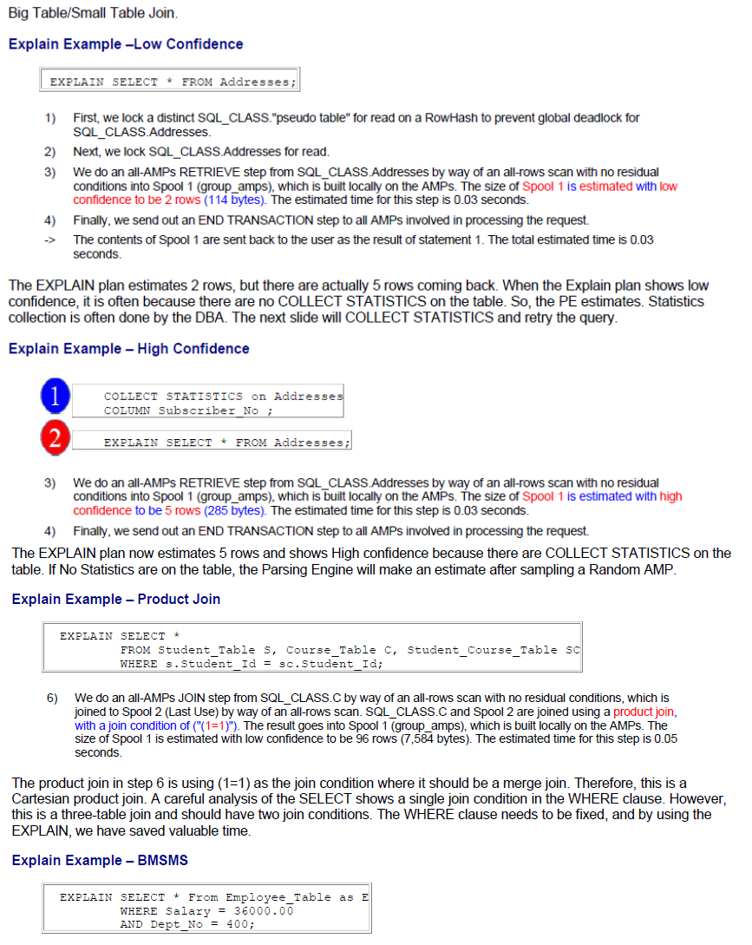
Teradata CoE
Teradata Lab Course

Slide 11
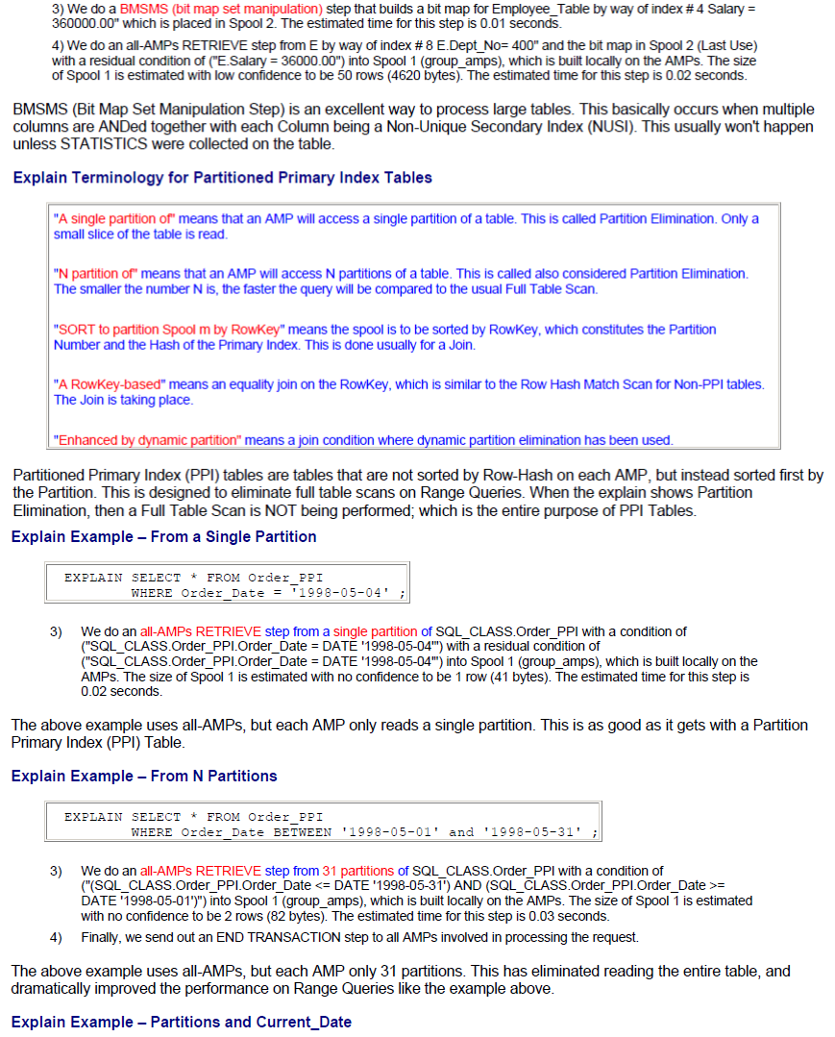
Teradata CoE
Teradata Lab Course

Slide 12
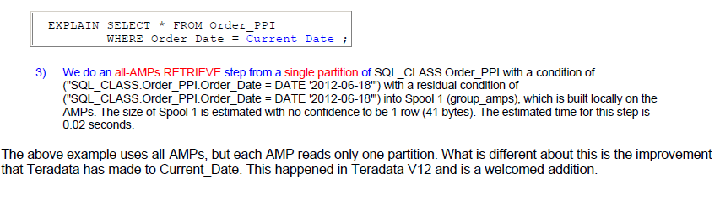
Teradata CoE
Teradata Lab Course

Slide 13
Teradata CoE
Teradata Lab Course
Format Functions

Slide 14
Teradata CoE
Teradata Lab Course
Format Functions

Slide 15
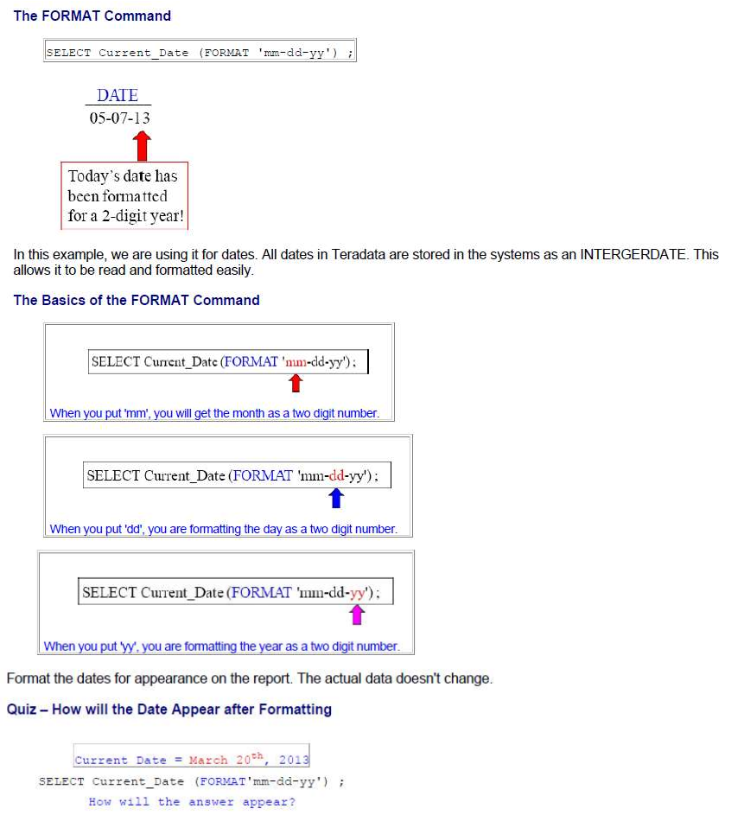
Teradata CoE
Teradata Lab Course

Slide 16
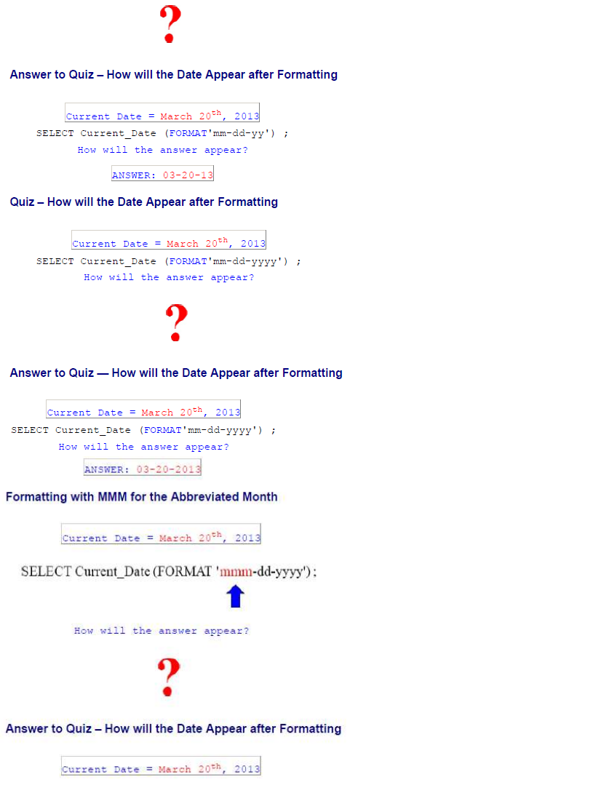
Teradata CoE
Teradata Lab Course

Slide 17
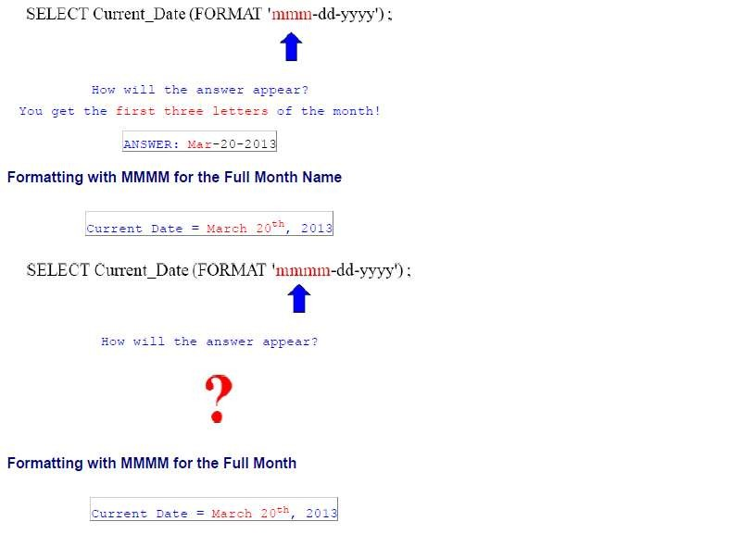
Teradata CoE
Teradata Lab Course

Slide 18
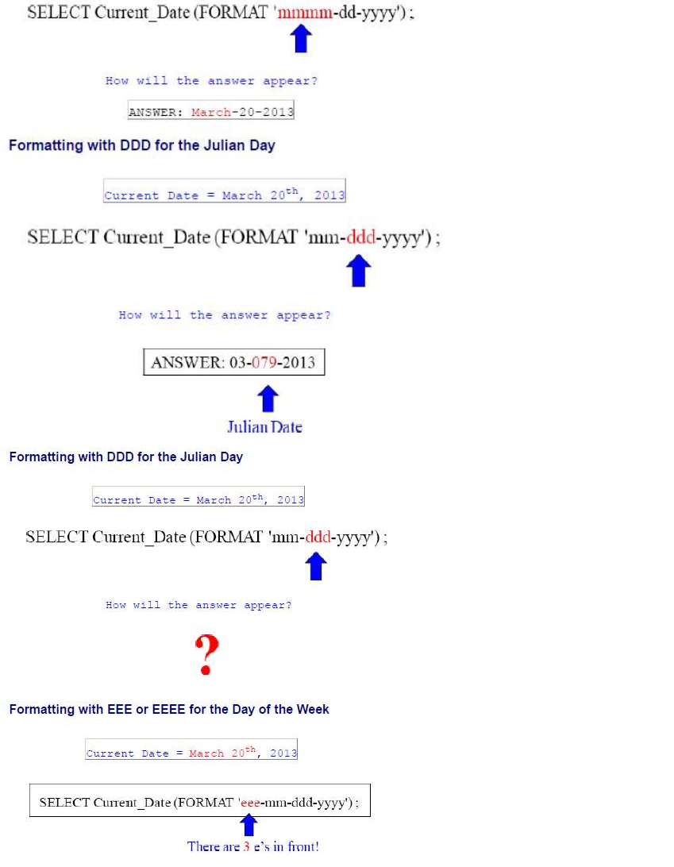
Teradata CoE
Teradata Lab Course

Slide 19
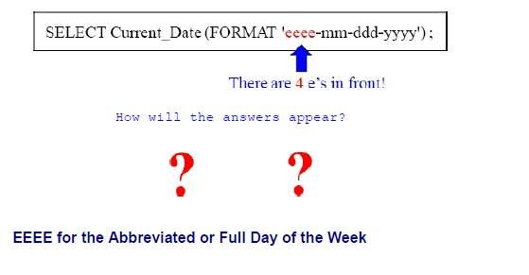
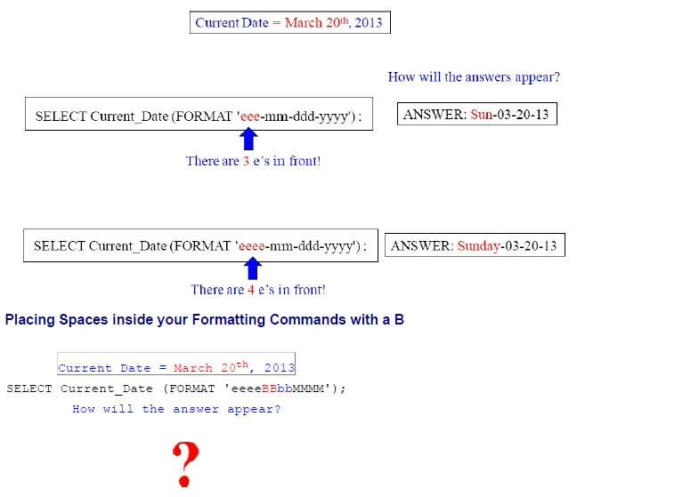
Teradata CoE
Teradata Lab Course

Slide 20
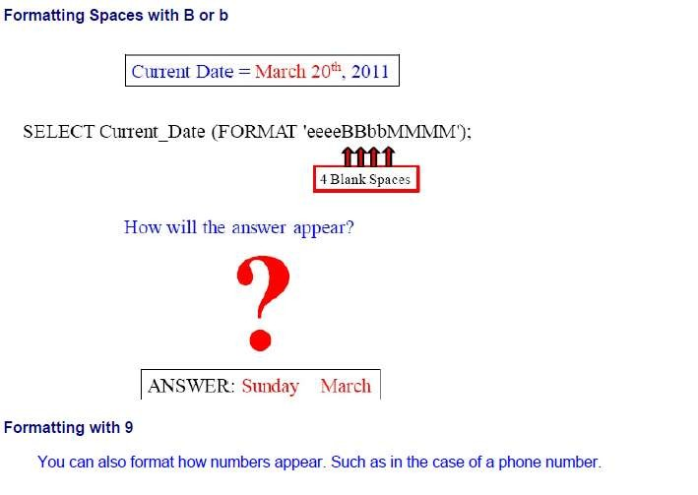
Teradata CoE
Teradata Lab Course

Slide 21
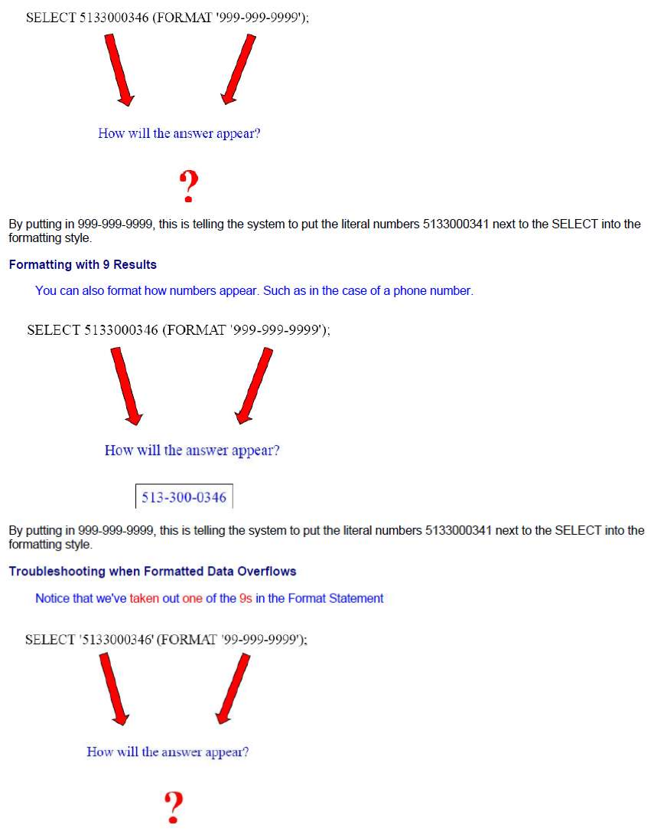
Teradata CoE
Teradata Lab Course

Slide 22
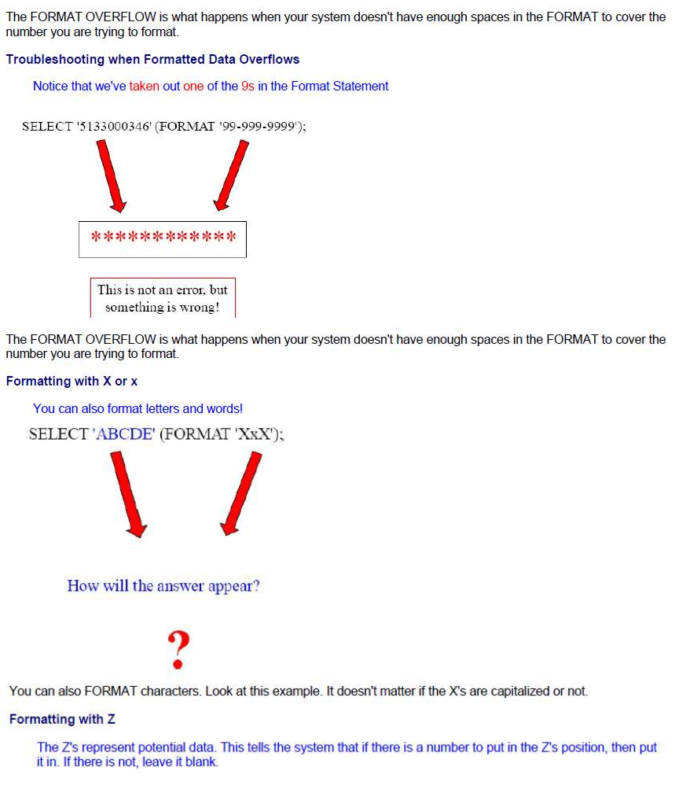
Teradata CoE
Teradata Lab Course

Slide 23
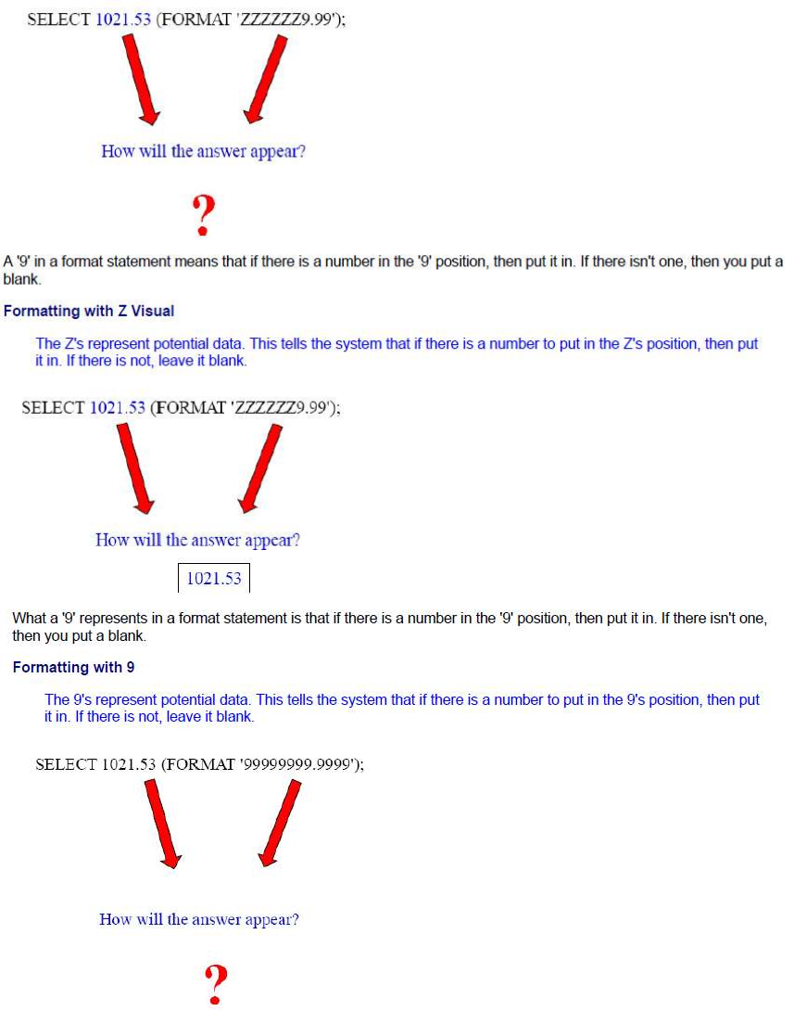
Teradata CoE
Teradata Lab Course

Slide 24
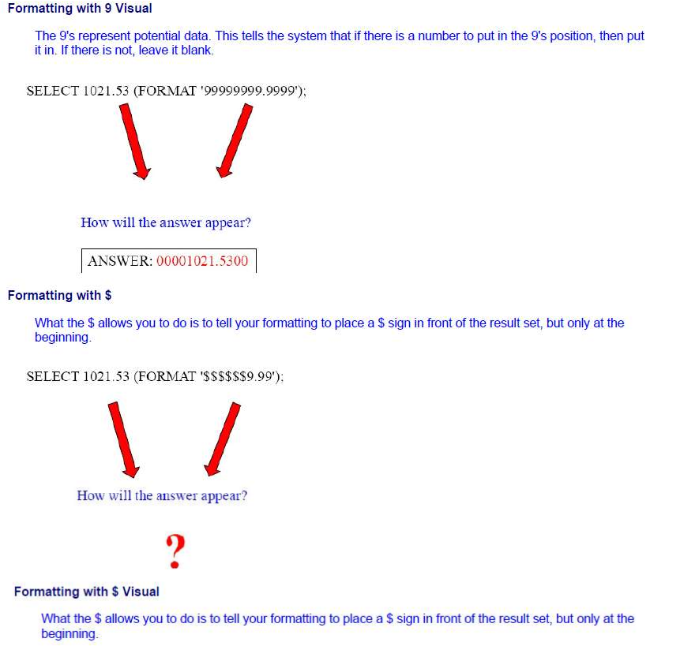
Teradata CoE
Teradata Lab Course

Slide 25
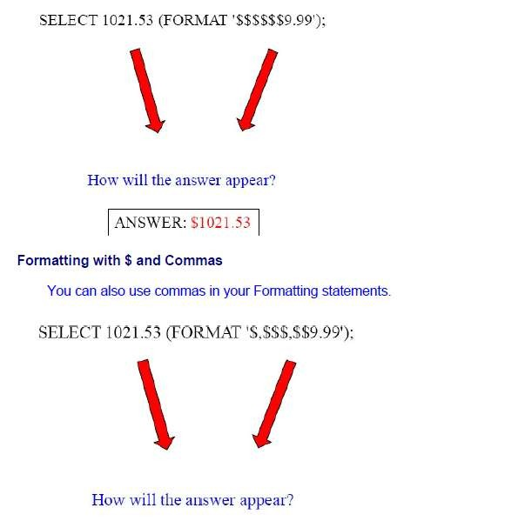
Teradata CoE
Teradata Lab Course

Slide 26
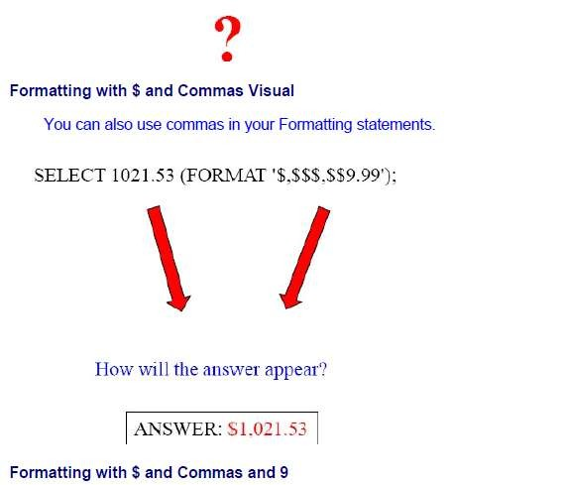
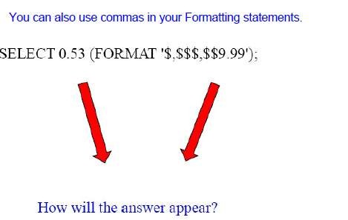
Teradata CoE
Teradata Lab Course

Slide 27
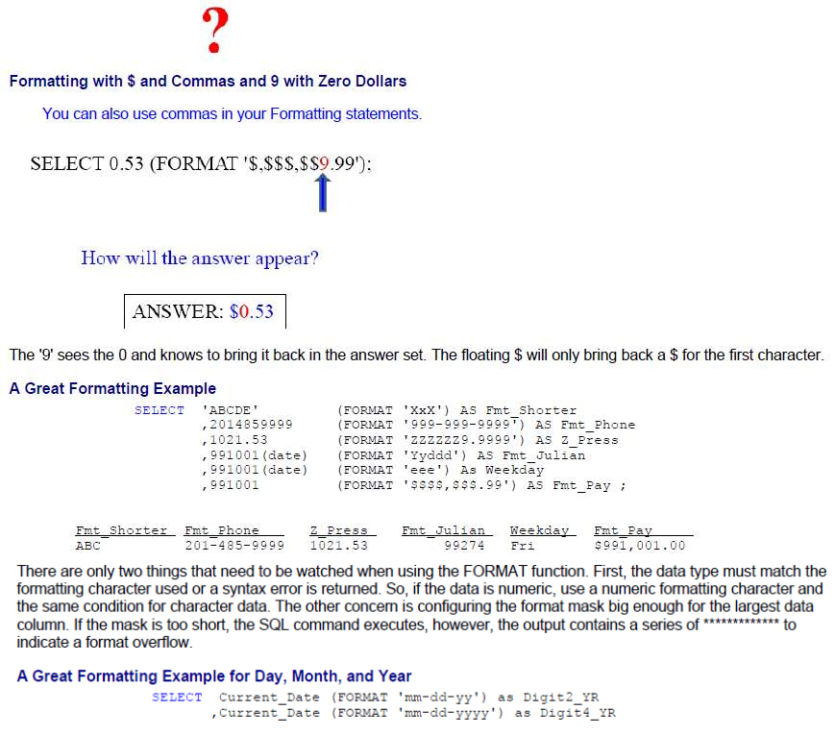
Teradata CoE
Teradata Lab Course

Slide 28
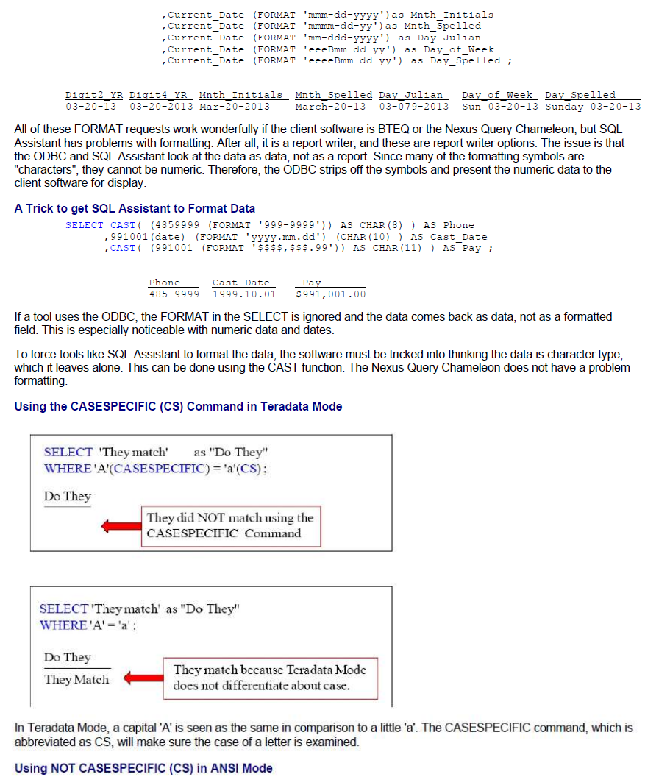
Teradata CoE
Teradata Lab Course

Slide 29
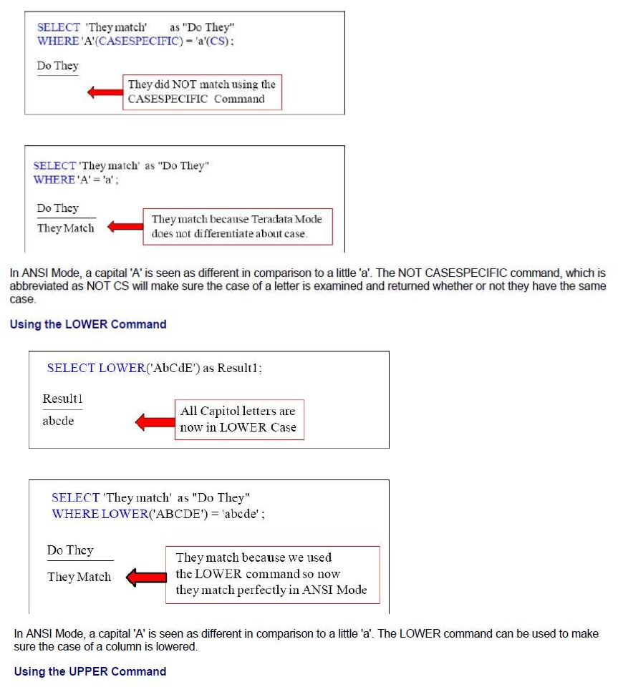
Teradata CoE
Teradata Lab Course

Slide 30
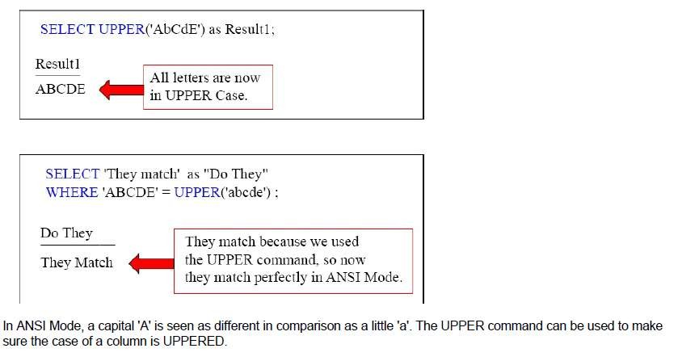
Teradata CoE
Teradata Lab Course

Slide 31
Teradata CoE
Teradata Lab Course
HELP and SHOW

Slide 32
Teradata CoE
Teradata Lab Course
HELP and SHOW

Slide 33
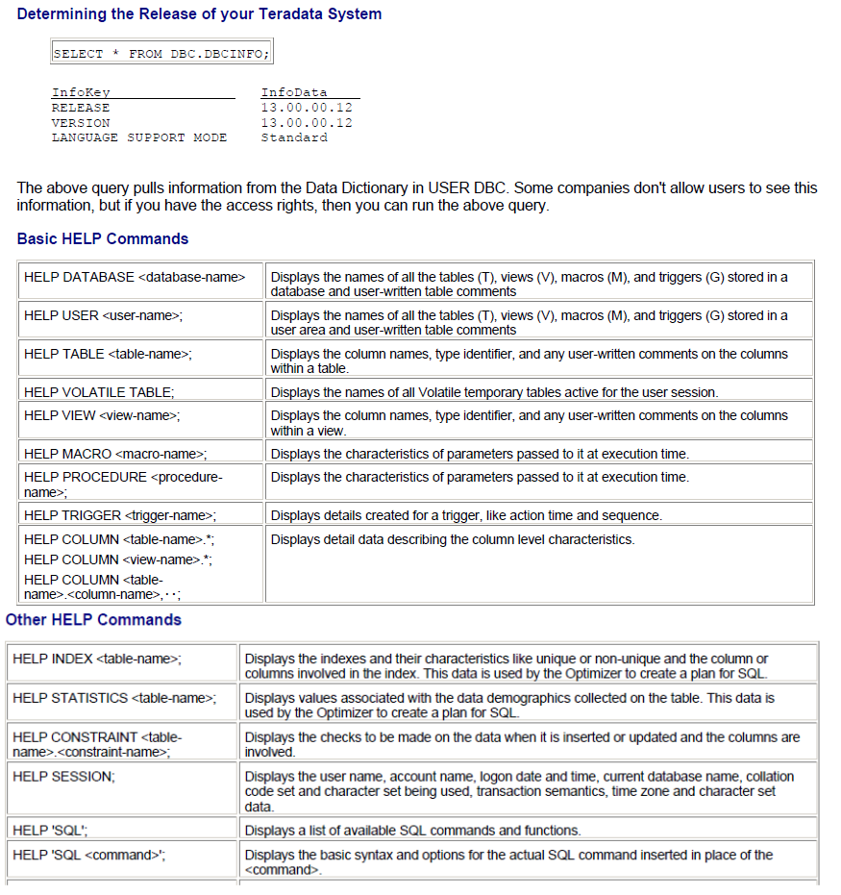
Teradata CoE
Teradata Lab Course

Slide 34
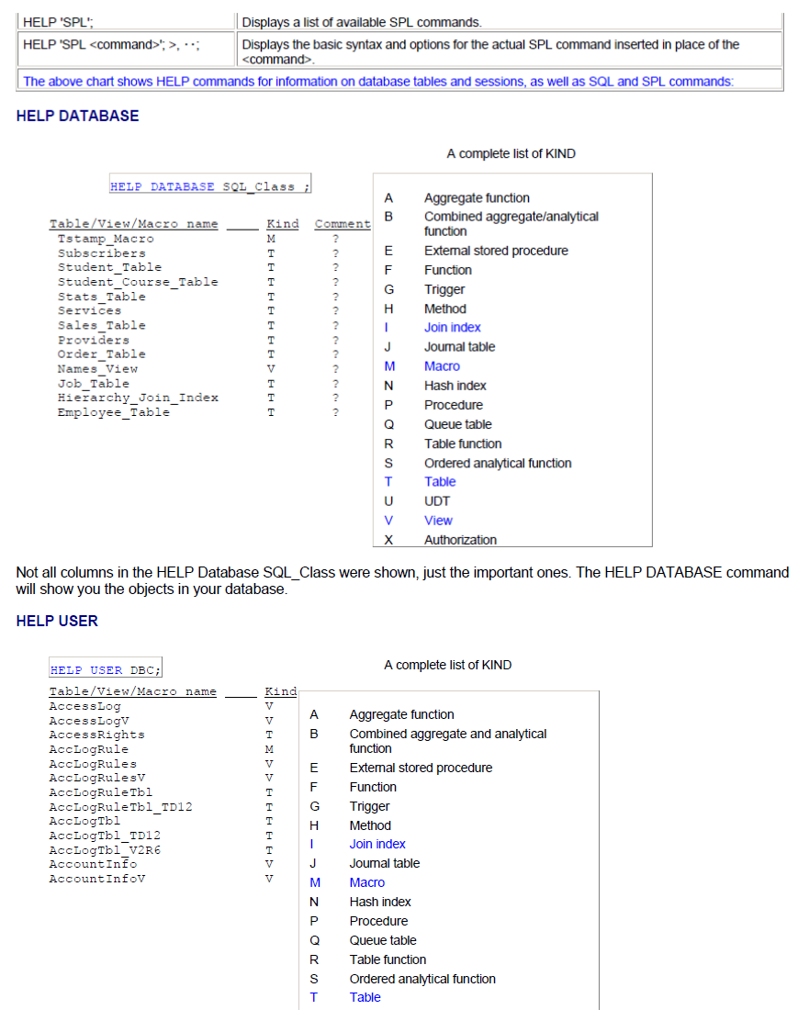
Teradata CoE
Teradata Lab Course

Slide 35
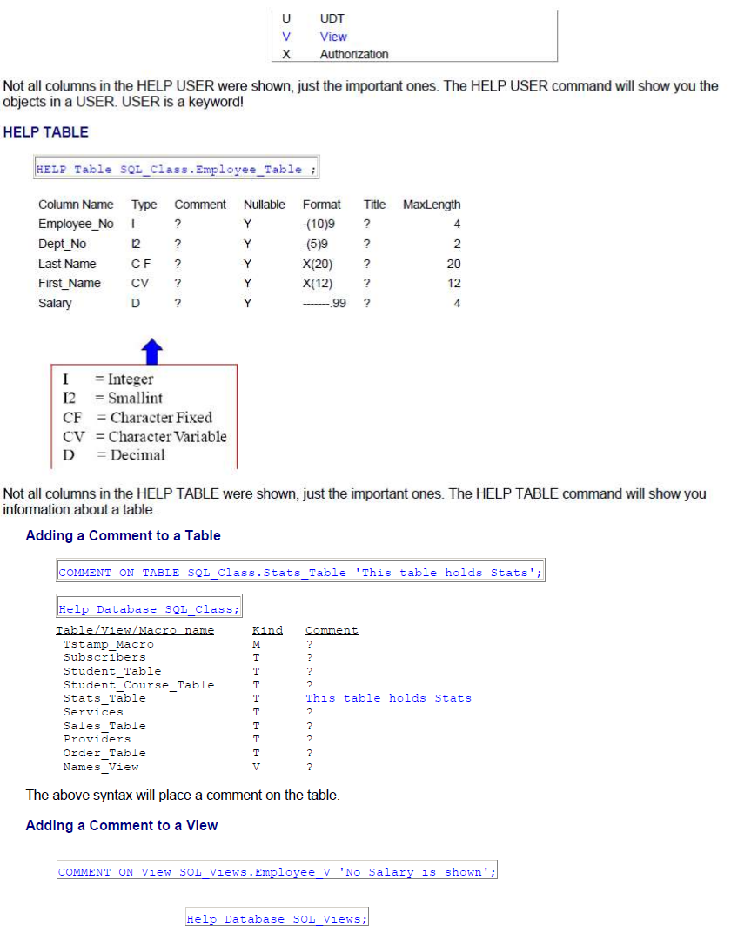
Teradata CoE
Teradata Lab Course

Slide 36
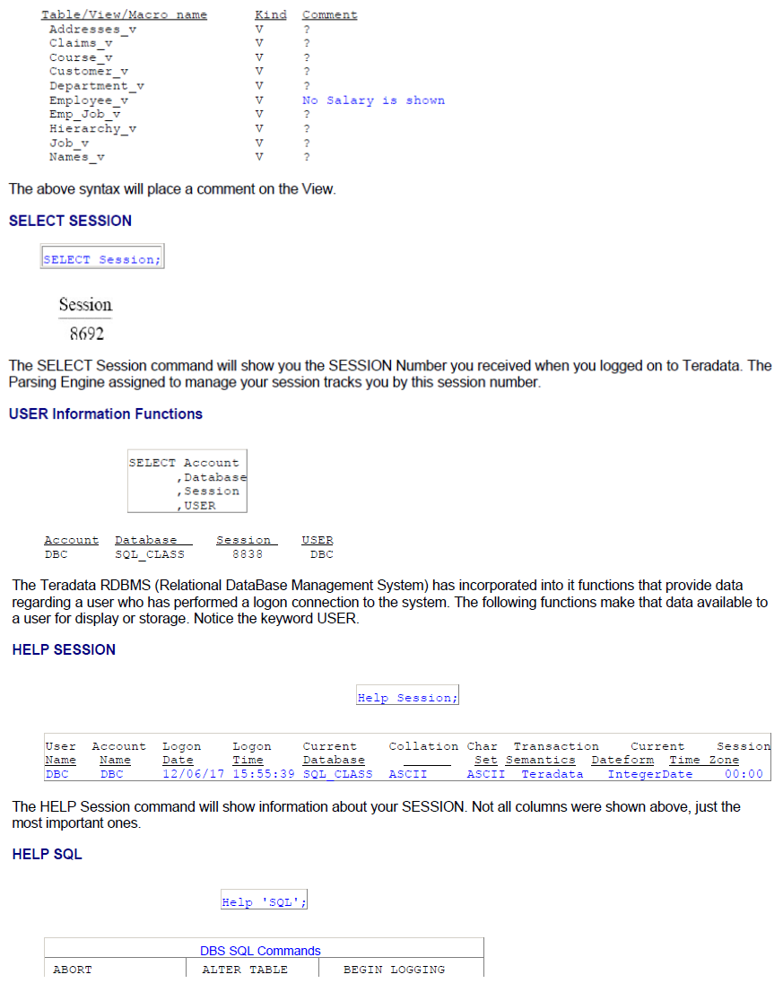
Teradata CoE
Teradata Lab Course

Slide 37
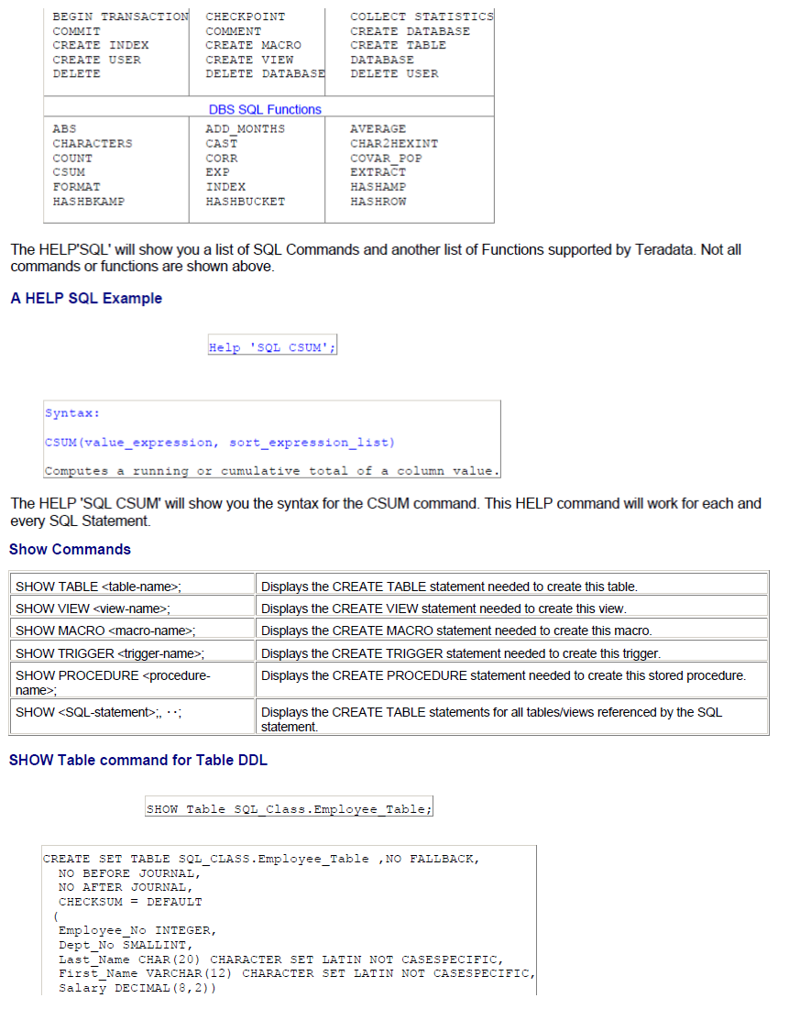
Teradata CoE
Teradata Lab Course

Slide 38
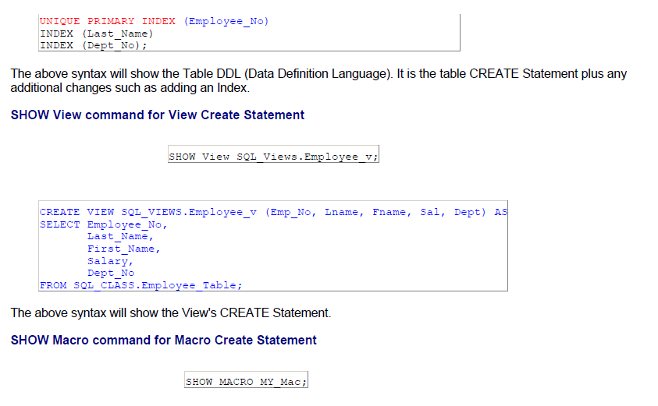
Teradata CoE
Teradata Lab Course

Slide 39
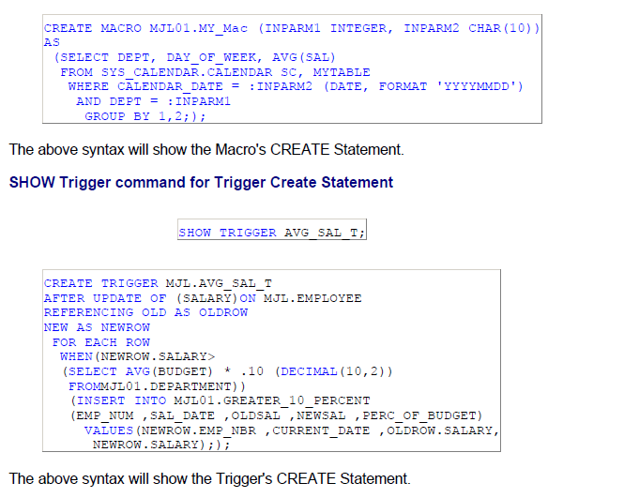
Teradata CoE
Teradata Lab Course

Slide 40
Teradata CoE
Teradata Lab Course
Join Functions

Slide 41
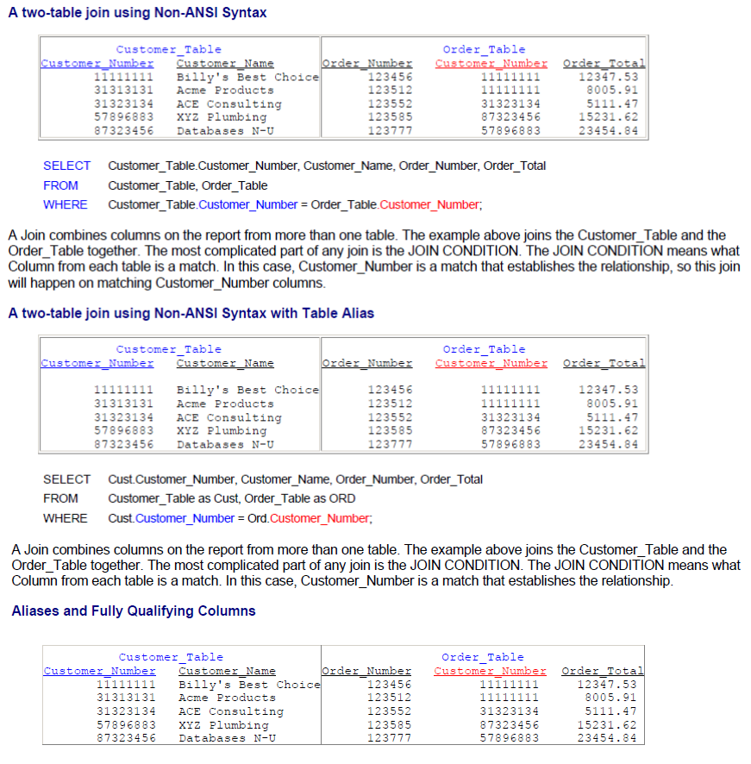
Teradata CoE
Teradata Lab Course
Join Functions

Slide 42
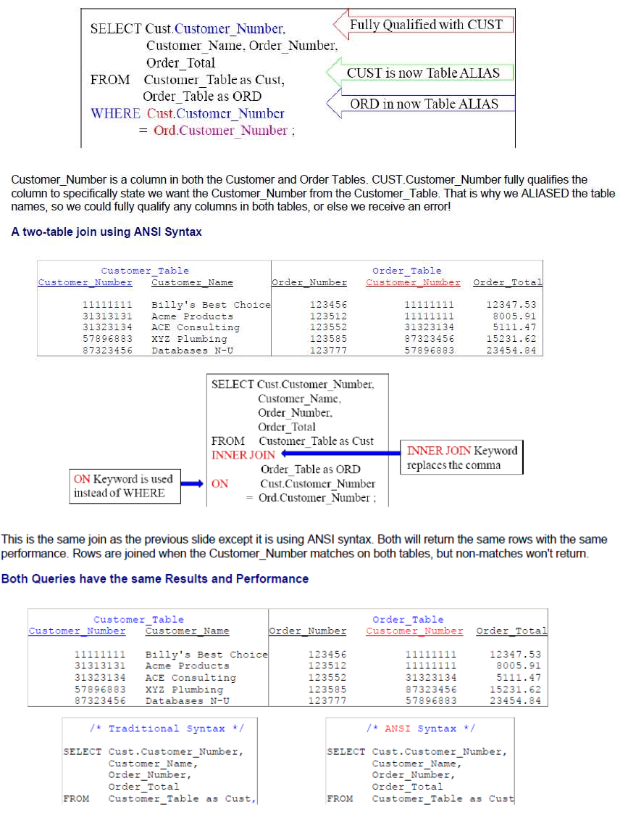
Teradata CoE
Teradata Lab Course

Slide 43
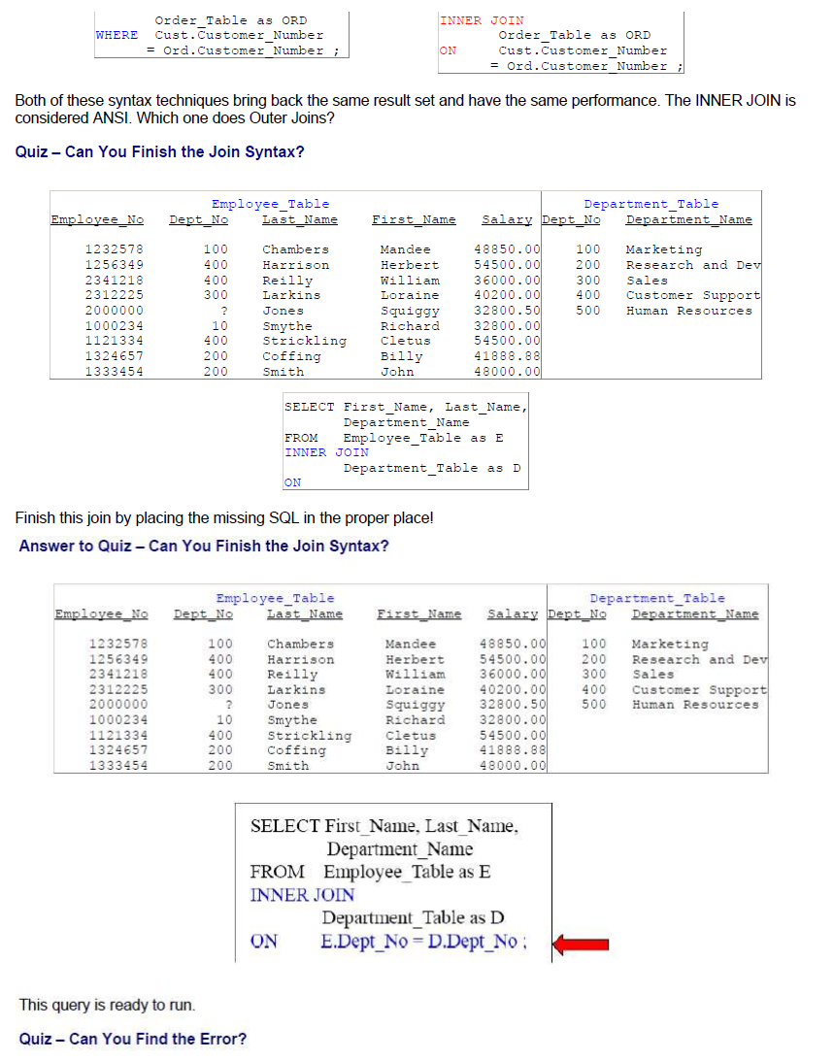
Teradata CoE
Teradata Lab Course

Slide 44
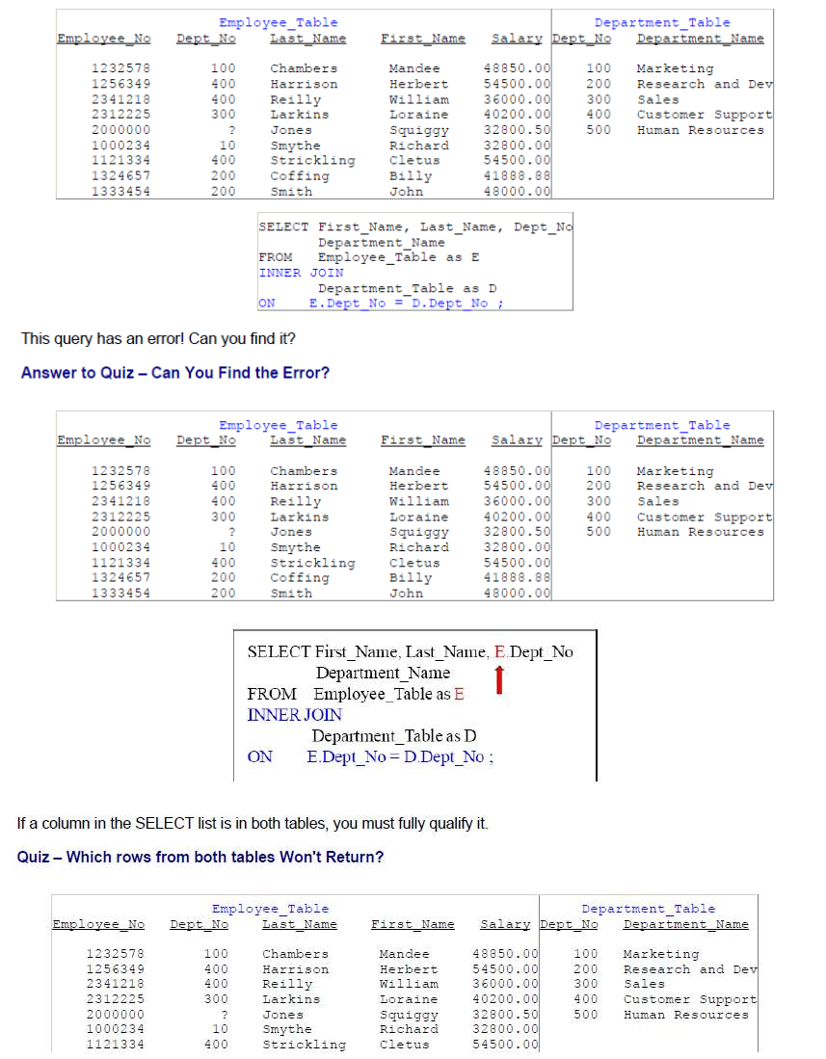
Teradata CoE
Teradata Lab Course

Slide 45
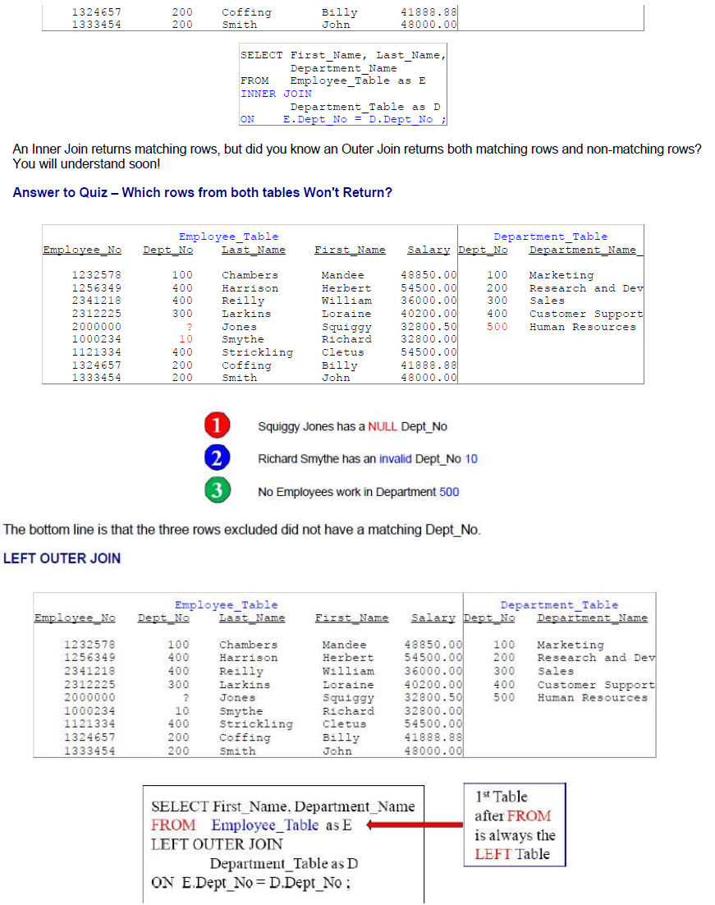
Teradata CoE
Teradata Lab Course

Slide 46
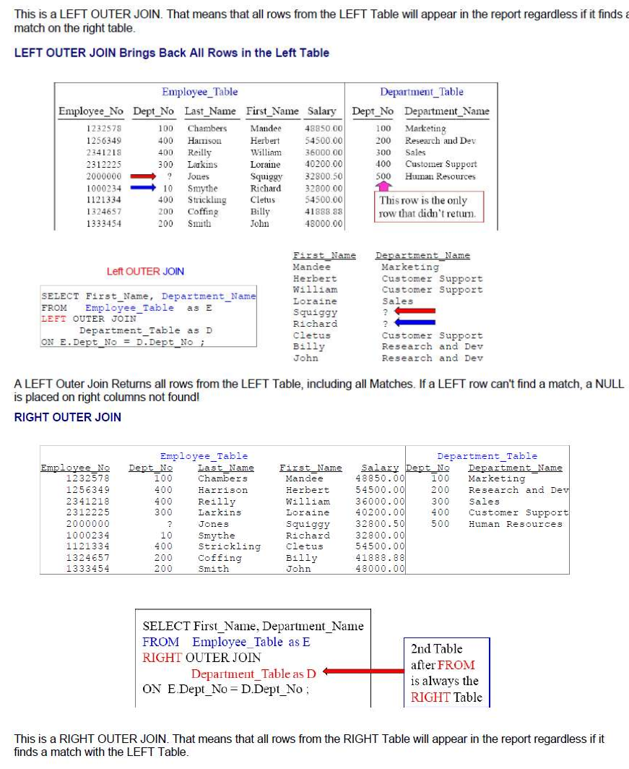
Teradata CoE
Teradata Lab Course

Slide 47
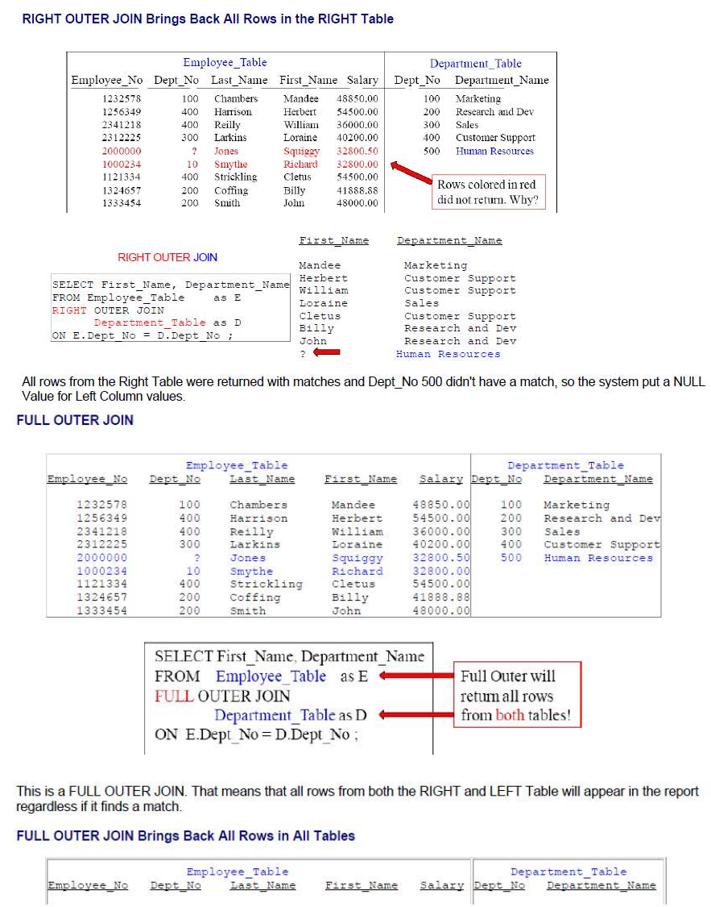
Teradata CoE
Teradata Lab Course

Slide 48
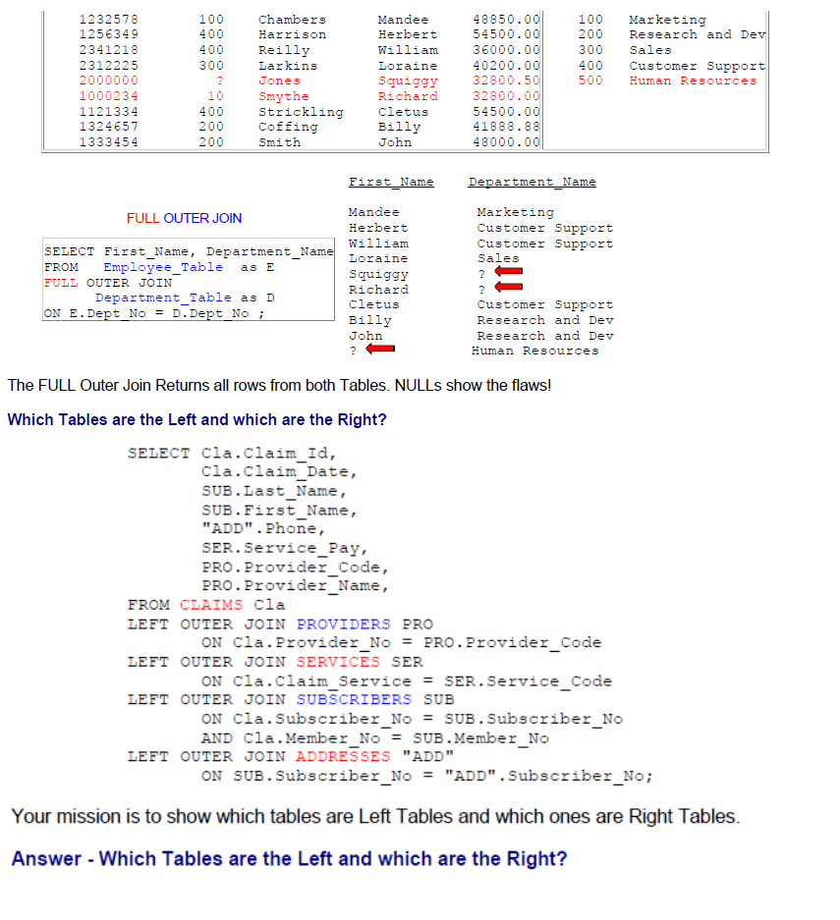
Teradata CoE
Teradata Lab Course

Slide 49
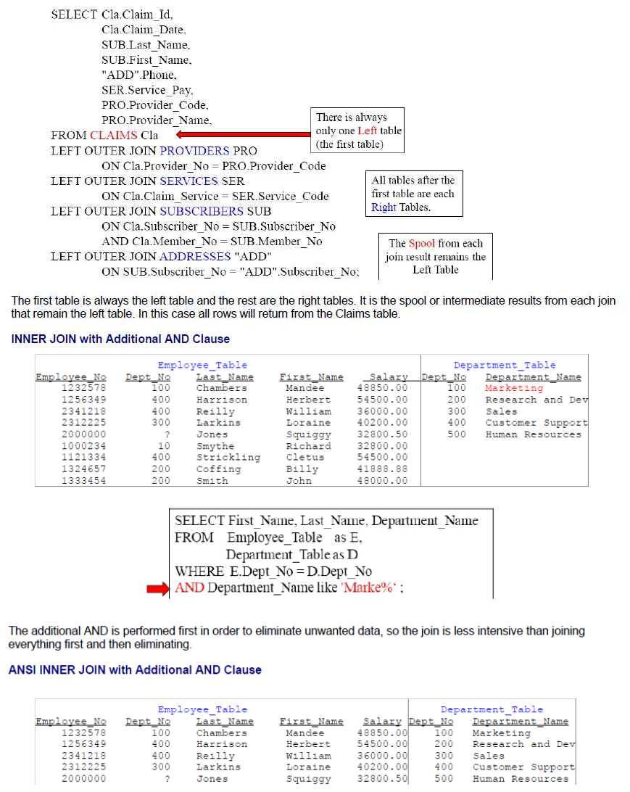
Teradata CoE
Teradata Lab Course

Slide 50
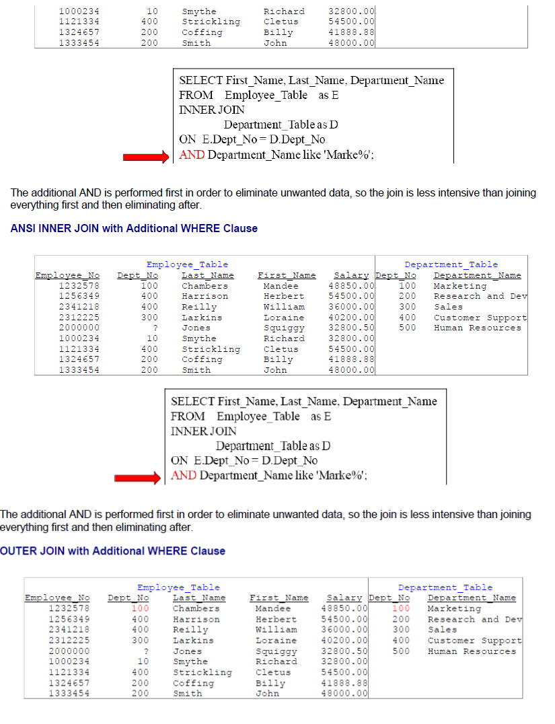
Teradata CoE
Teradata Lab Course

Slide 51
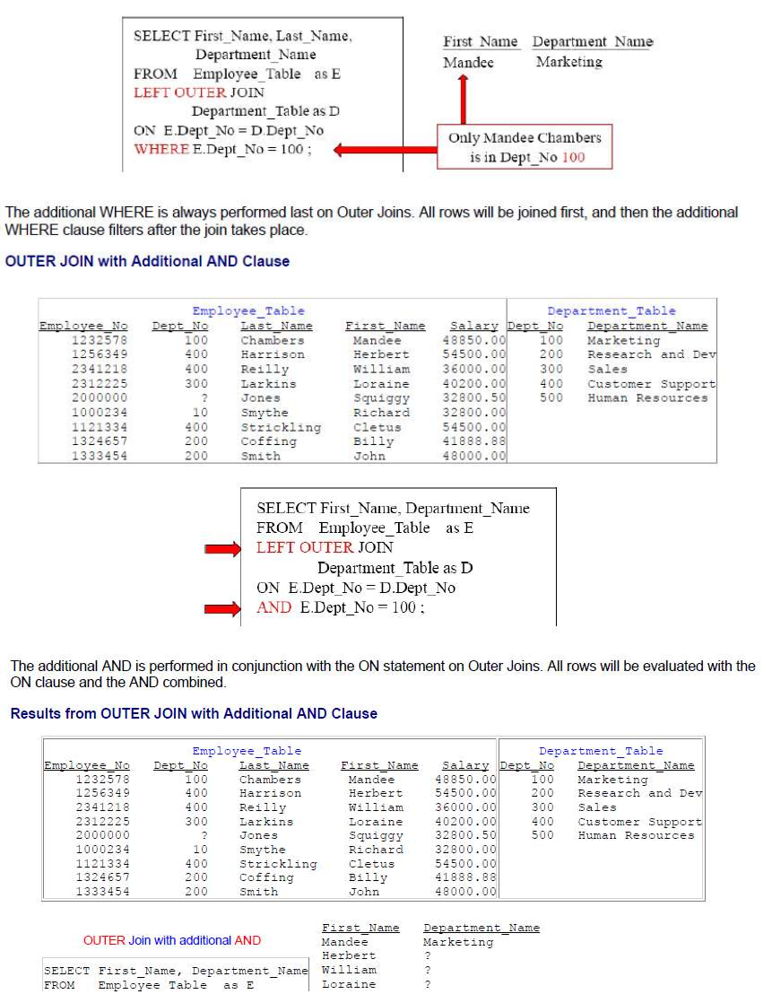
Teradata CoE
Teradata Lab Course

Slide 52
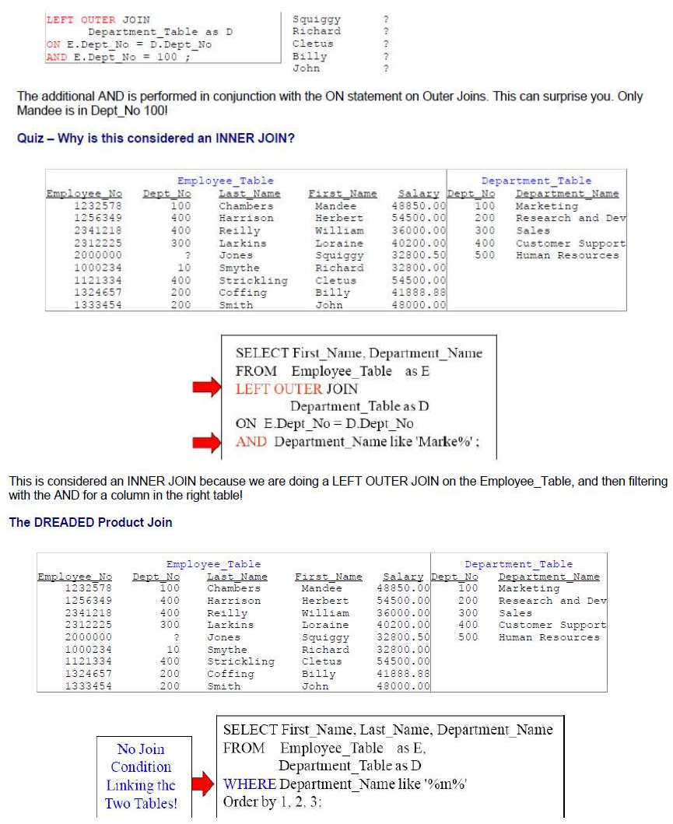
Teradata CoE
Teradata Lab Course

Slide 53
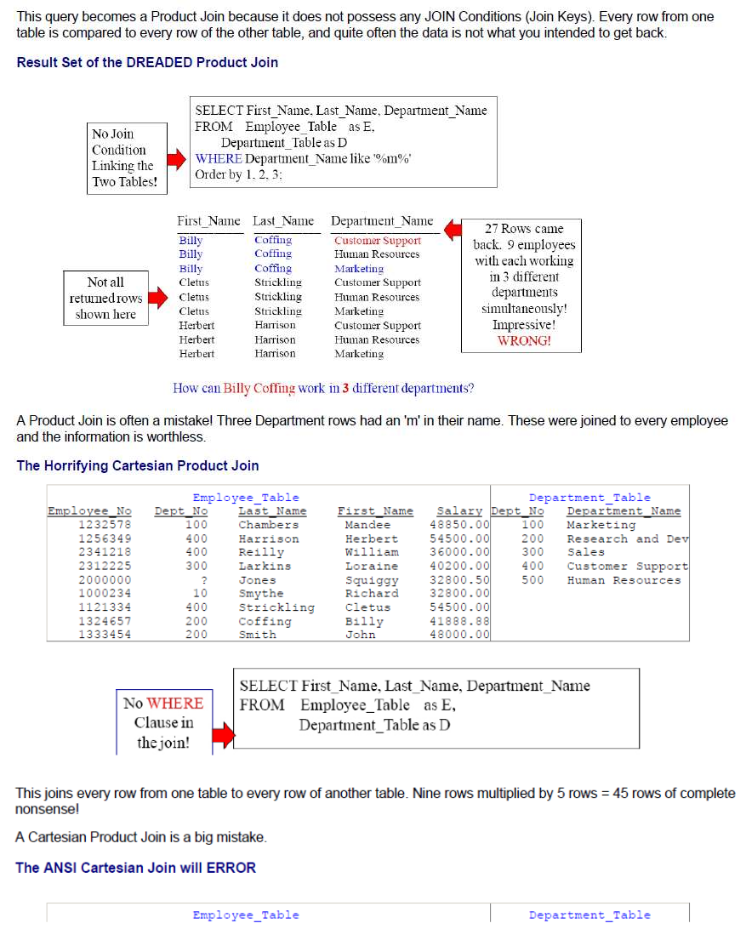
Teradata CoE
Teradata Lab Course

Slide 54
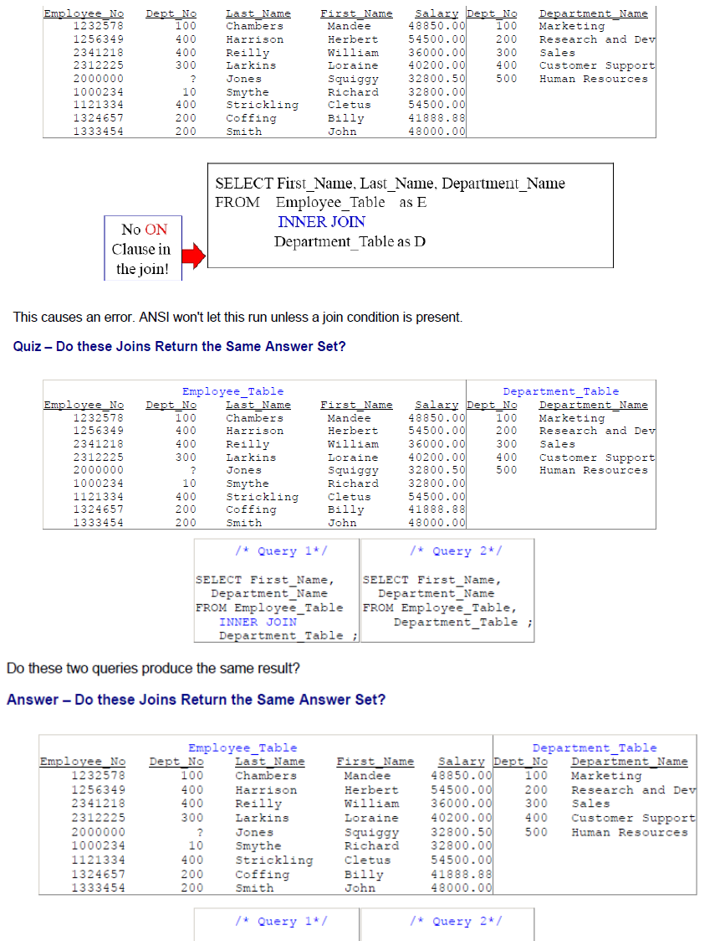
Teradata CoE
Teradata Lab Course

Slide 55
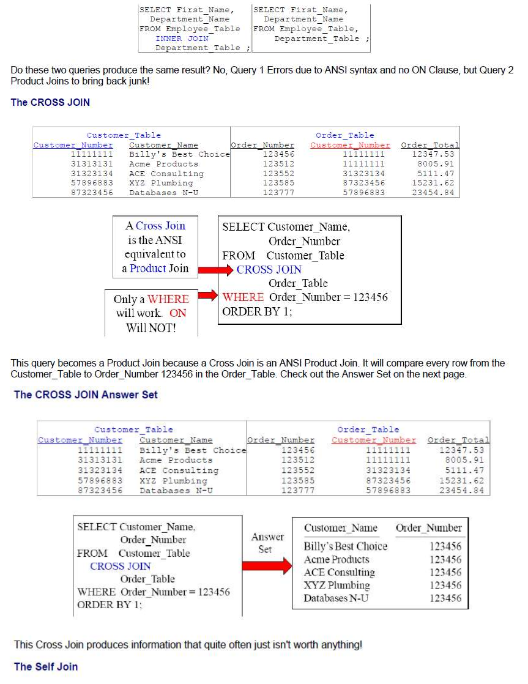
Teradata CoE
Teradata Lab Course

Slide 56
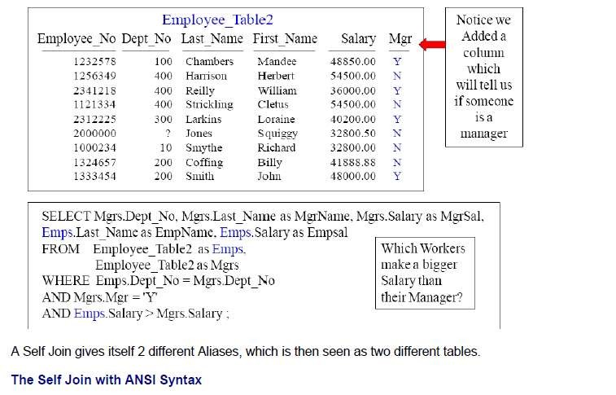
Teradata CoE
Teradata Lab Course

Slide 57

Teradata CoE
Teradata Lab Course

Slide 58

Teradata CoE
Teradata Lab Course

Slide 59

Teradata CoE
Teradata Lab Course

Slide 60

Teradata CoE
Teradata Lab Course

Slide 61

Teradata CoE
Teradata Lab Course

Slide 62

Teradata CoE
Teradata Lab Course

Slide 63

Teradata CoE
Teradata Lab Course

Slide 64

Teradata CoE
Teradata Lab Course

Slide 65

Teradata CoE
Teradata Lab Course

Slide 66


Teradata CoE
Teradata Lab Course

Slide 67

Teradata CoE
Teradata Lab Course

Slide 68

Teradata CoE
Teradata Lab Course

Slide 69

Teradata CoE
Teradata Lab Course

Slide 70

Teradata CoE
Teradata Lab Course

Slide 71
Teradata CoE
Teradata Lab Course
Join Indexes

Slide 72

Teradata CoE
Teradata Lab Course
Join Indexes

Slide 73

Teradata CoE
Teradata Lab Course

Slide 74

Teradata CoE
Teradata Lab Course

Slide 75

Teradata CoE
Teradata Lab Course

Slide 76

Teradata CoE
Teradata Lab Course

Slide 77

Teradata CoE
Teradata Lab Course

Slide 78


Teradata CoE
Teradata Lab Course

